Slide 1

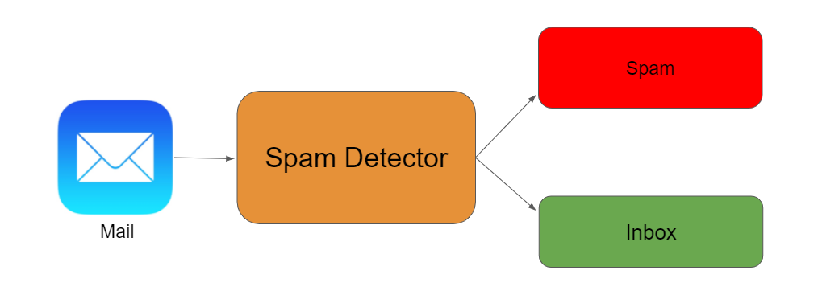
Spam and Ham Detection
By,
Manoj.I.V
Data trained Batch No.:1842
Fliprobo Technology

Slide 2
Business Problem
The SMS Spam Collection is a set of SMS tagged messages that have been collected for SMS Spam research. It contains one set of SMS messages in English of 5,574 messages, tagged according being ham (legitimate) or spam.
Spam Detector is used to detect unwanted, malicious and virus infected texts and helps to separate them from the nonspam texts. It uses a binary type of classification containing the labels such as ‘ham’ (nonspam) and spam. Application of this can be seen in Google Mail (GMAIL) where it segregates the spam emails in order to prevent them from getting into the user’s inbox.
The files contain one message per line. Each line is composed by two columns: v1 contains the label (ham or spam) and v2 contains the raw text.
This corpus has been collected from free or free for research sources at the Internet:
A collection of 5573 rows SMS spam messages was manually extracted from the Grumbletext Web site. This is a UK forum in which cell phone users make public claims about SMS spam messages, most of them without reporting the very spam message received. The identification of the text of spam messages in the claims is a very hard and time-consuming task, and it involved carefully scanning hundreds of web pages.
A subset of 3,375 SMS randomly chosen ham messages of the NUS SMS Corpus (NSC), which is a dataset of about 10,000 legitimate messages collected for research at the Department of Computer Science at the National University of Singapore. The messages largely originate from Singaporeans and mostly from students attending the University. These messages were collected from volunteers who were made aware that their contributions were going to be made publicly available.

Slide 3
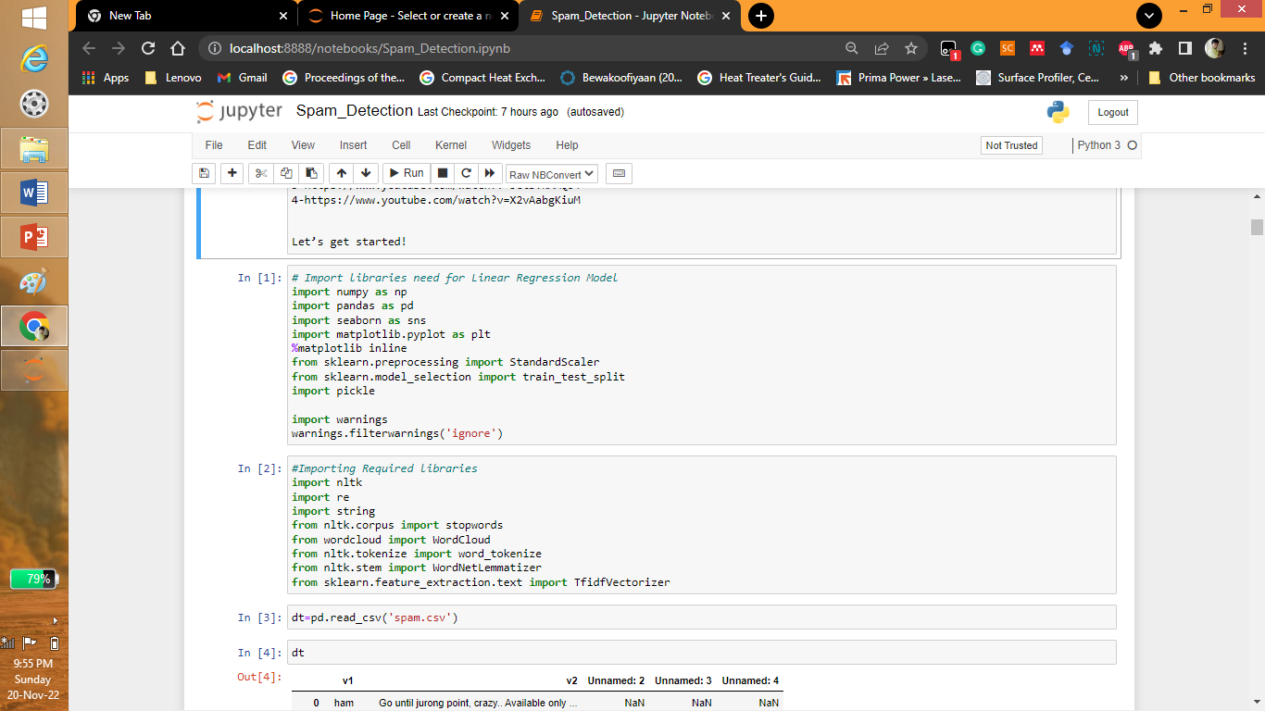
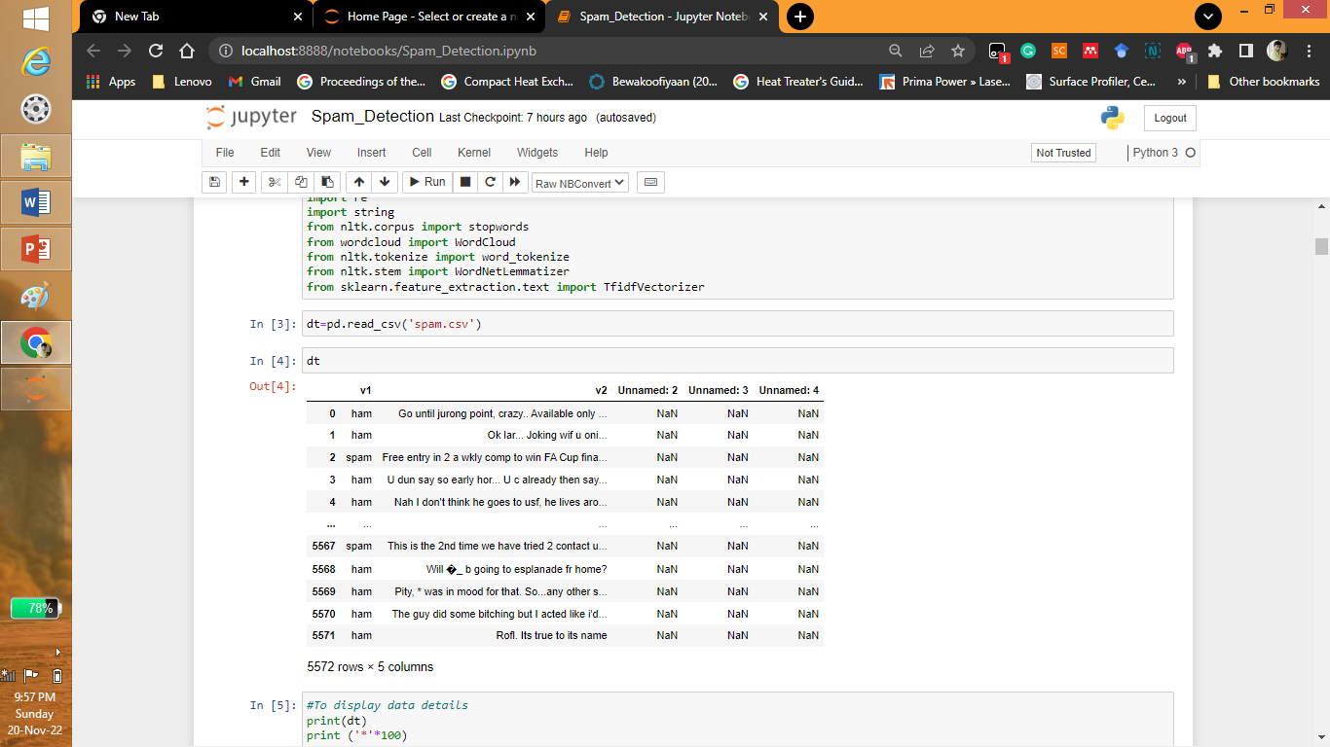
Importing Libraries and Dataset

Slide 4
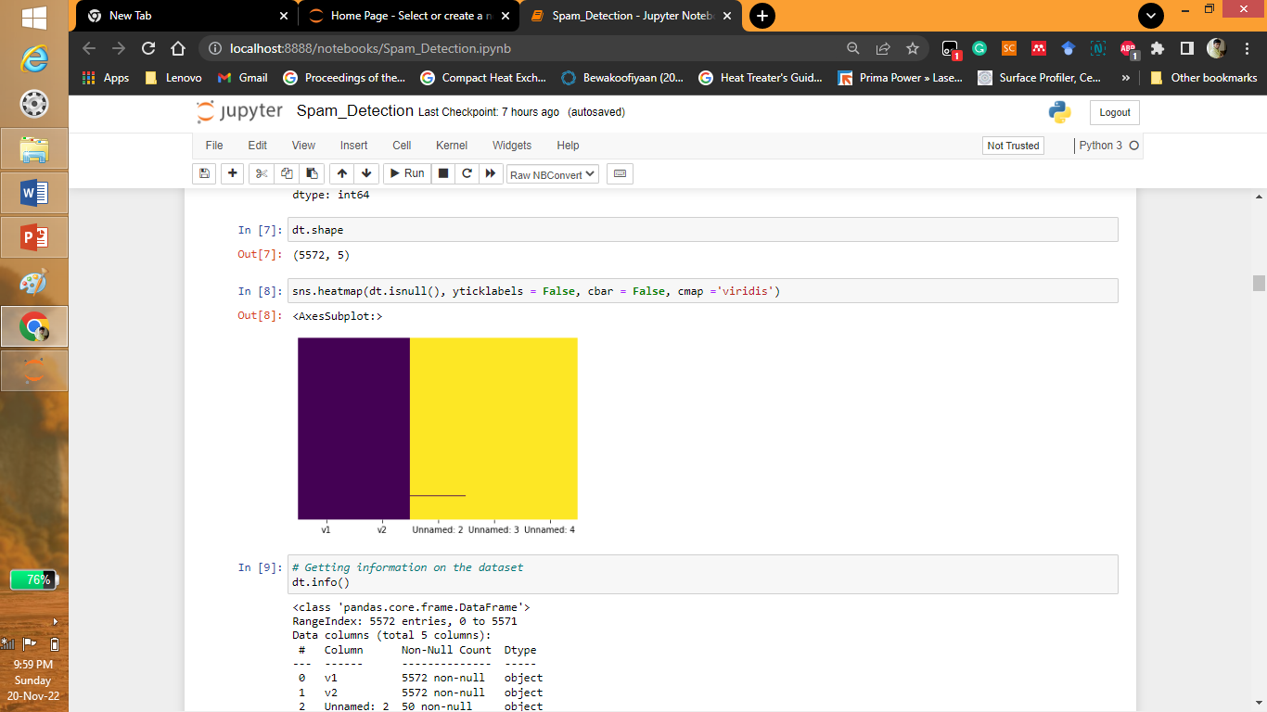
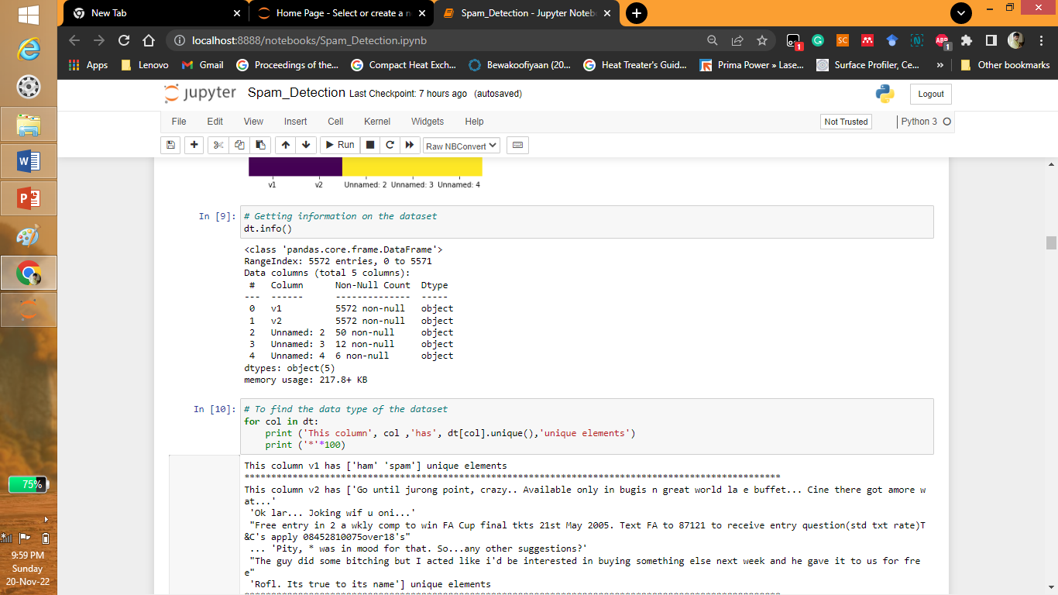
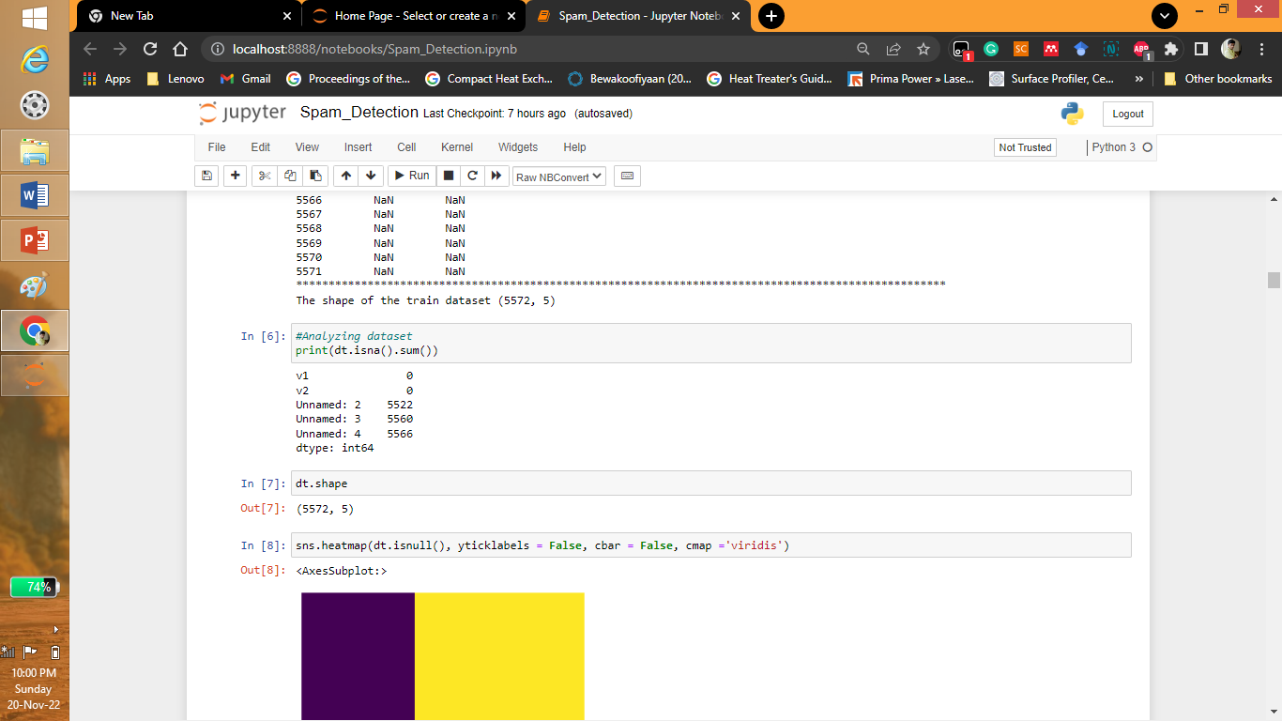
Exploring Dataset

Slide 5
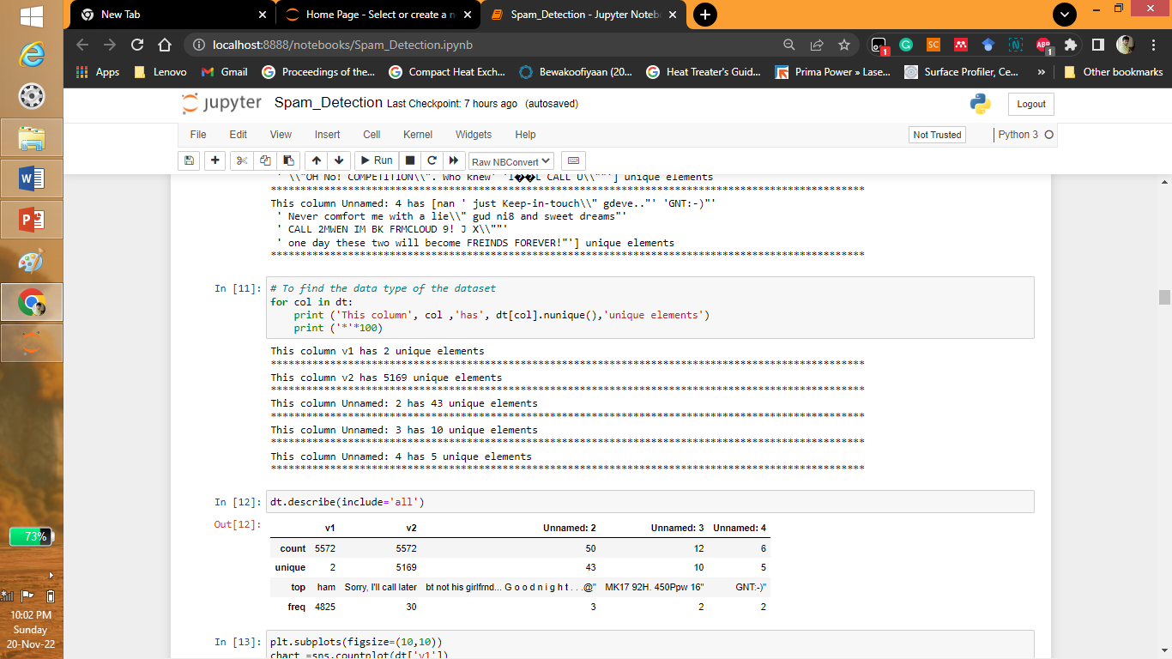
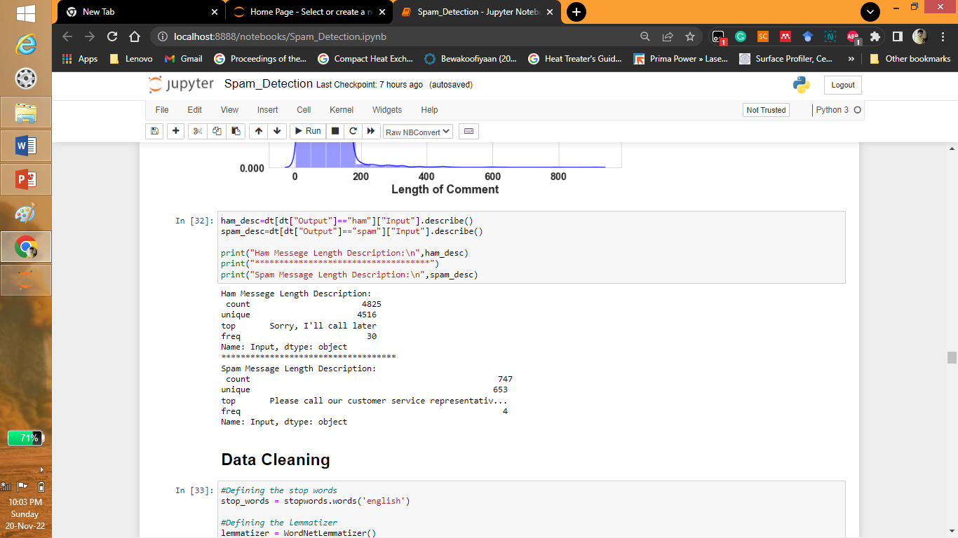
Exploring Dataset

Slide 6
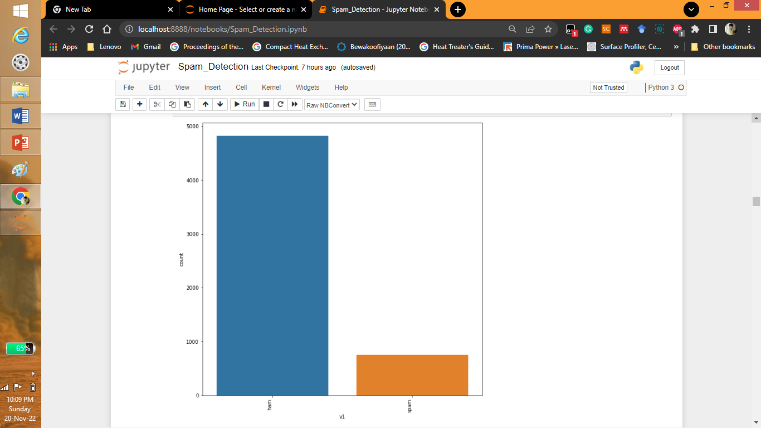
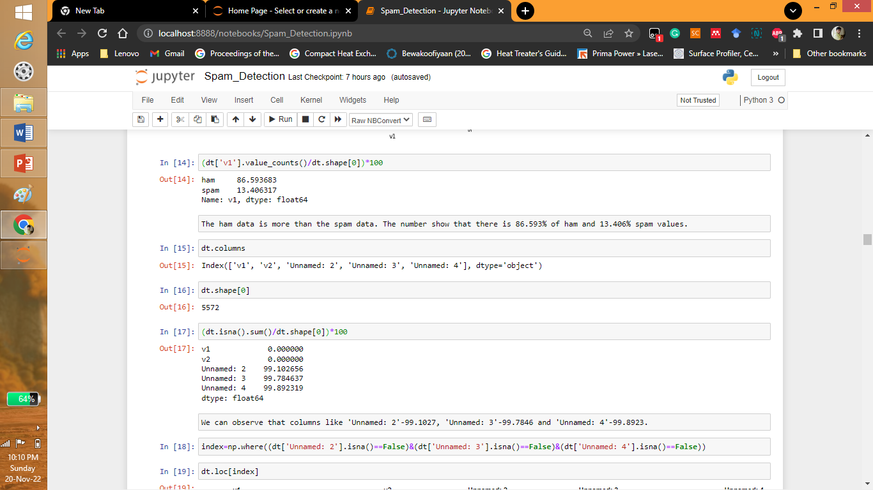
Analyzing the Output

Slide 7
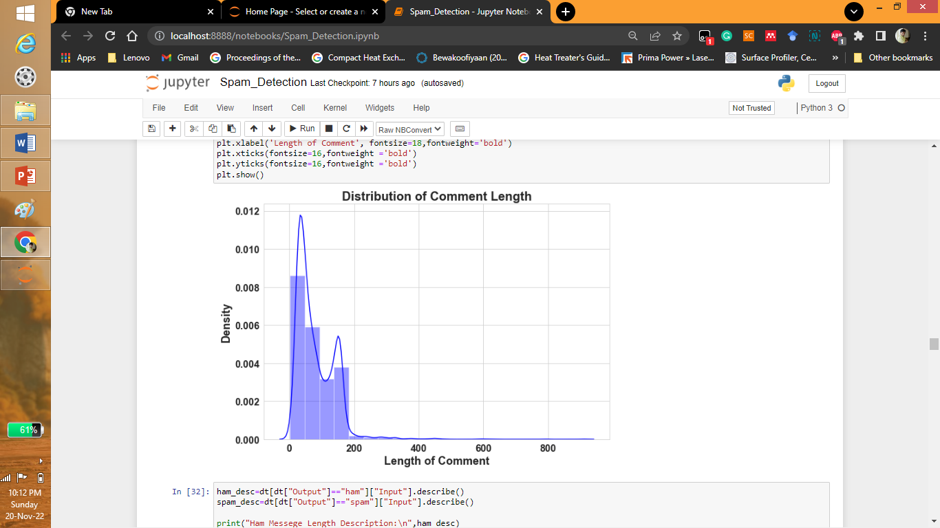
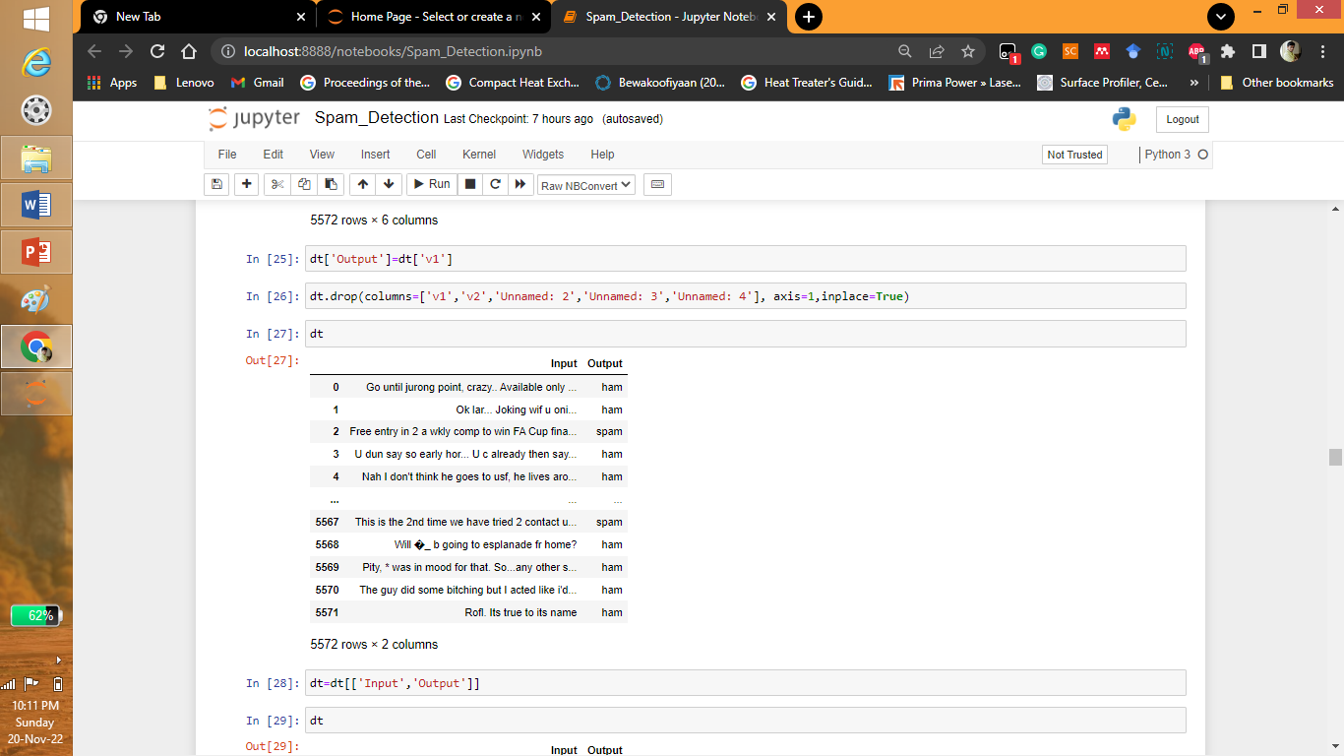
Analyzing the Input

Slide 8
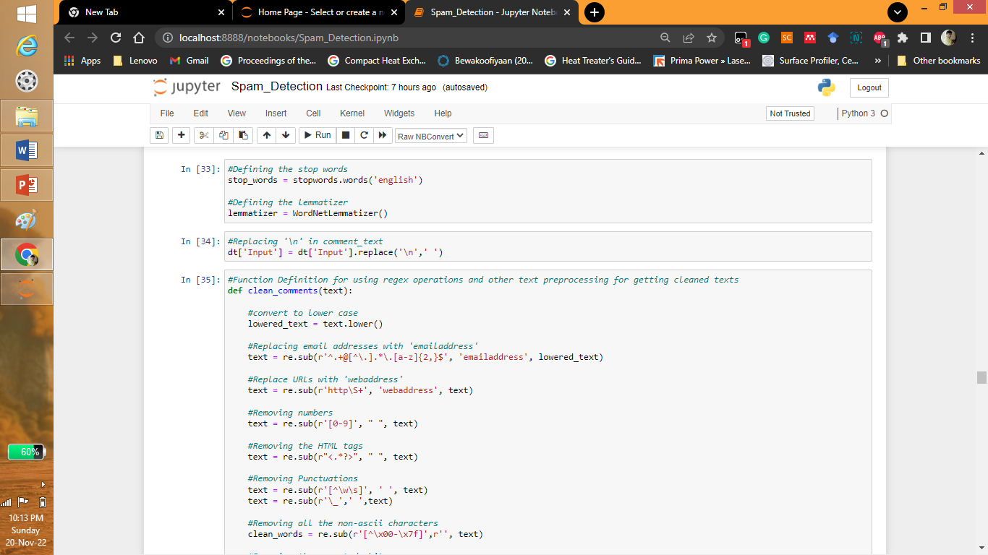
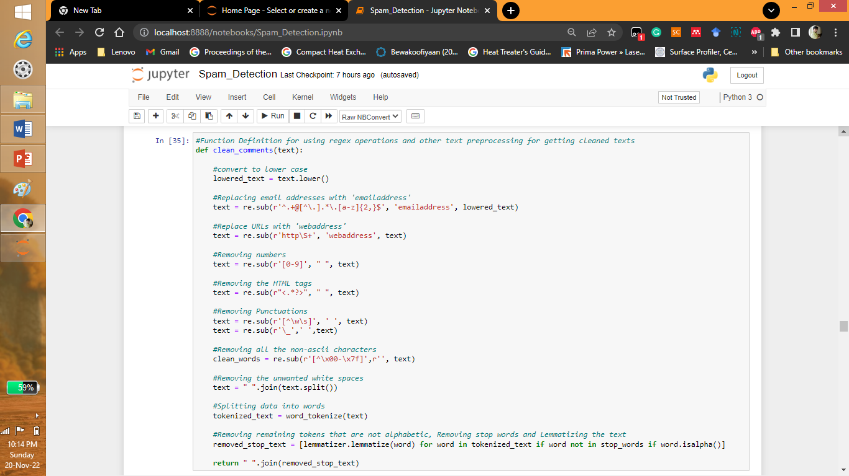
Data Cleaning

Slide 9
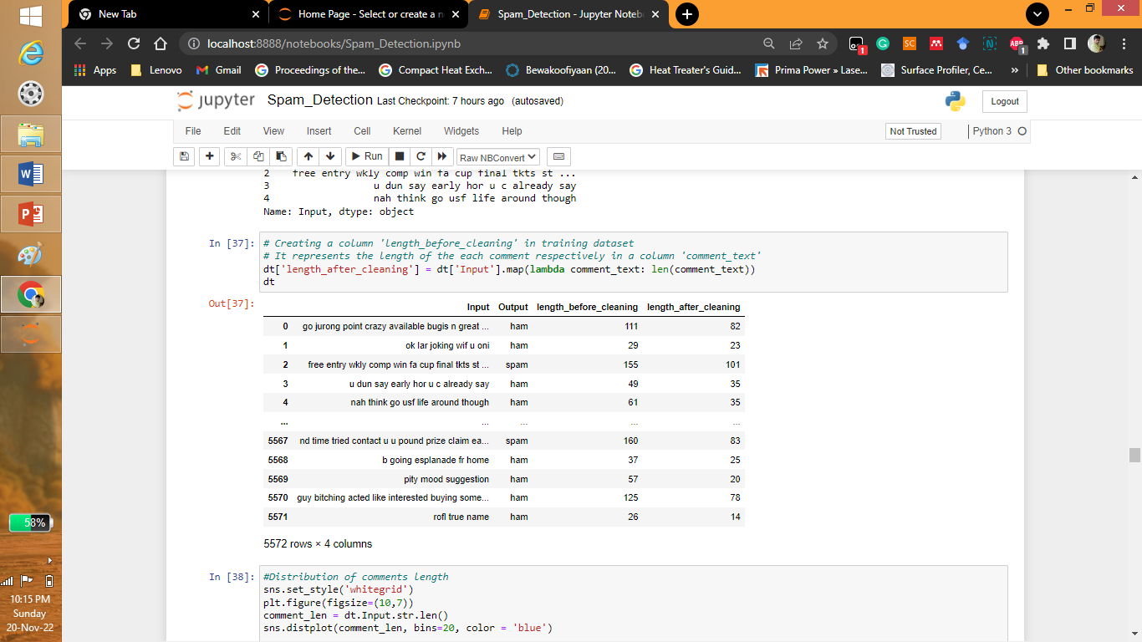
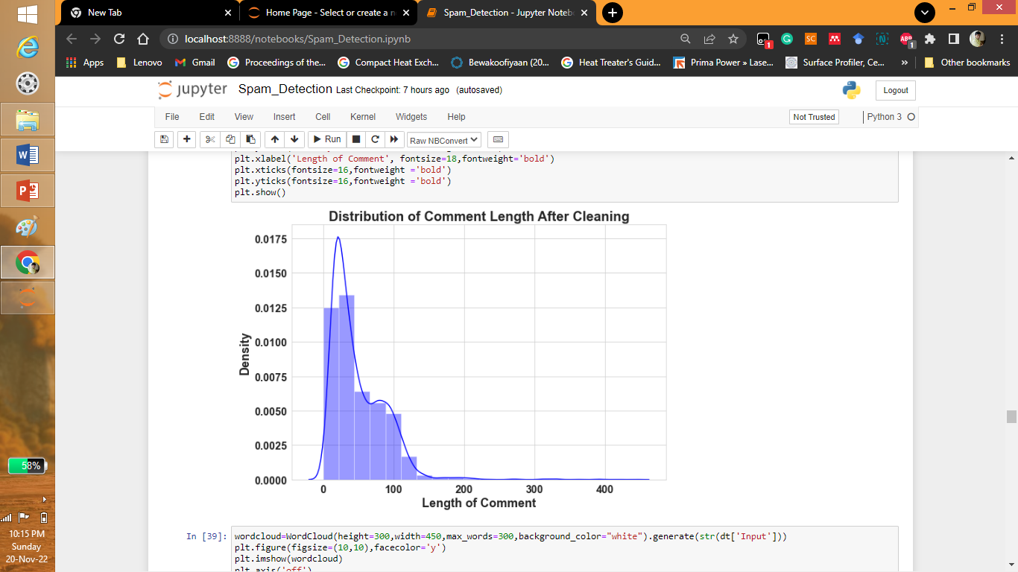
Data Cleaning

Slide 10
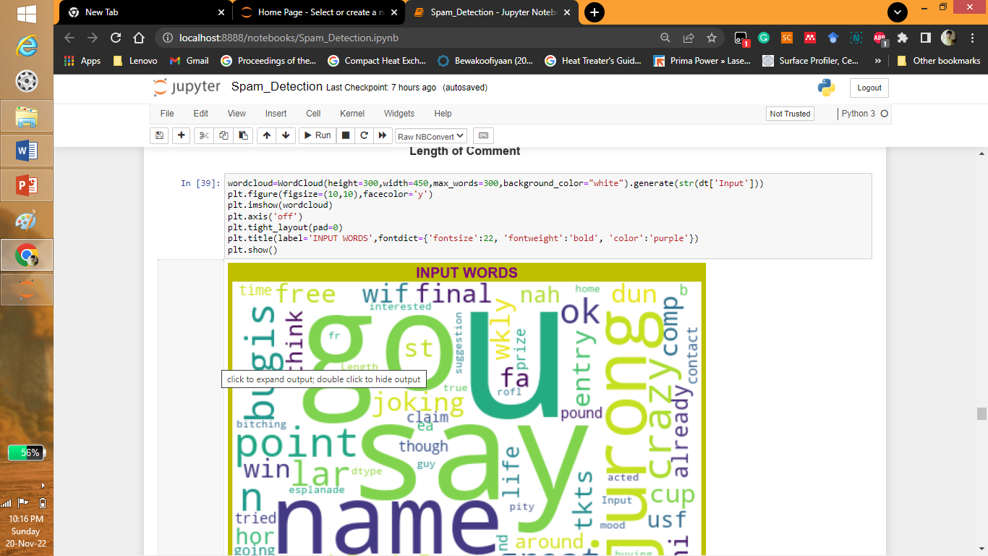
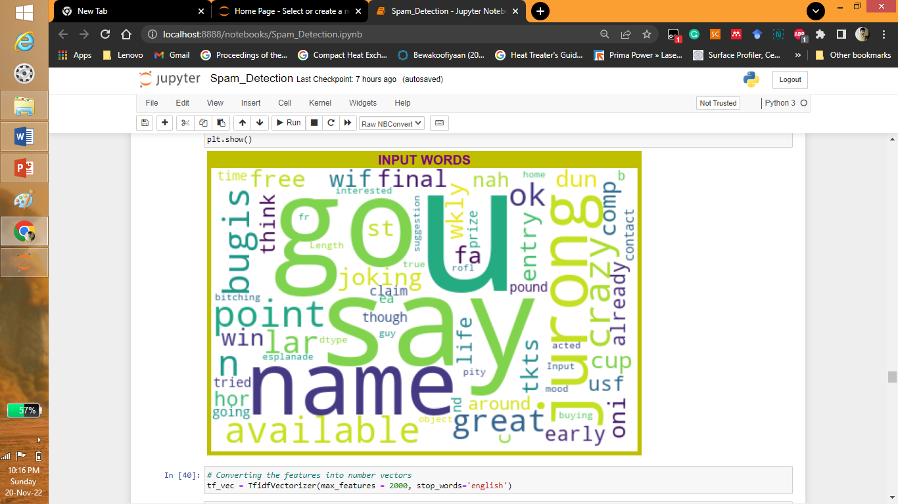
Data Visualization

Slide 11
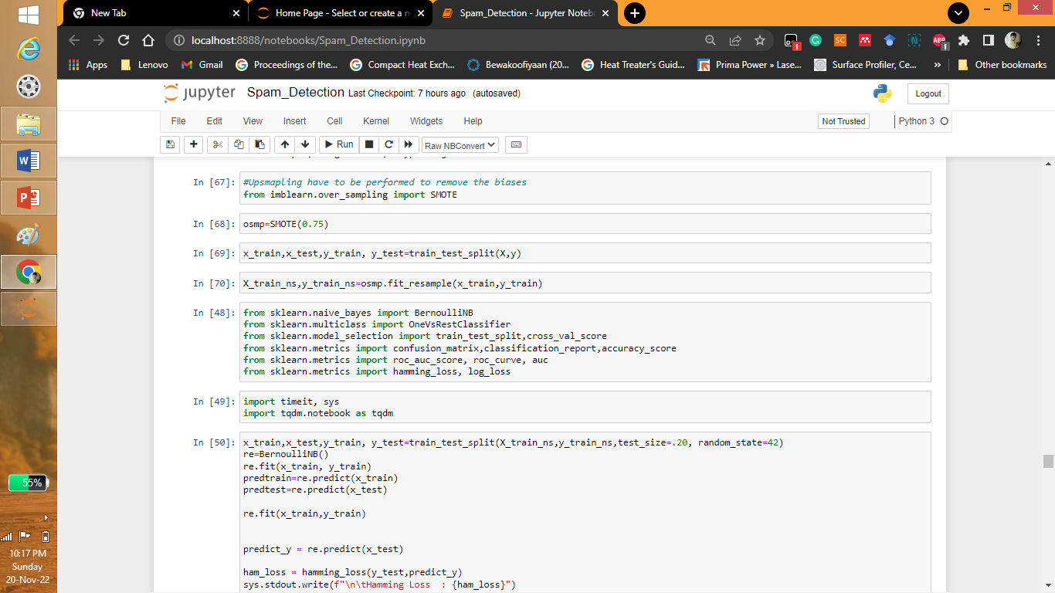
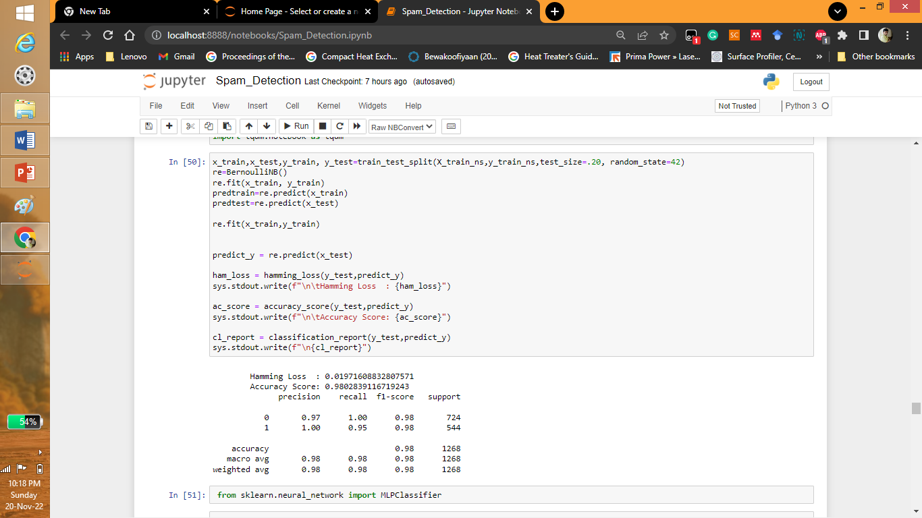
Oversampling and Model Building

Slide 12
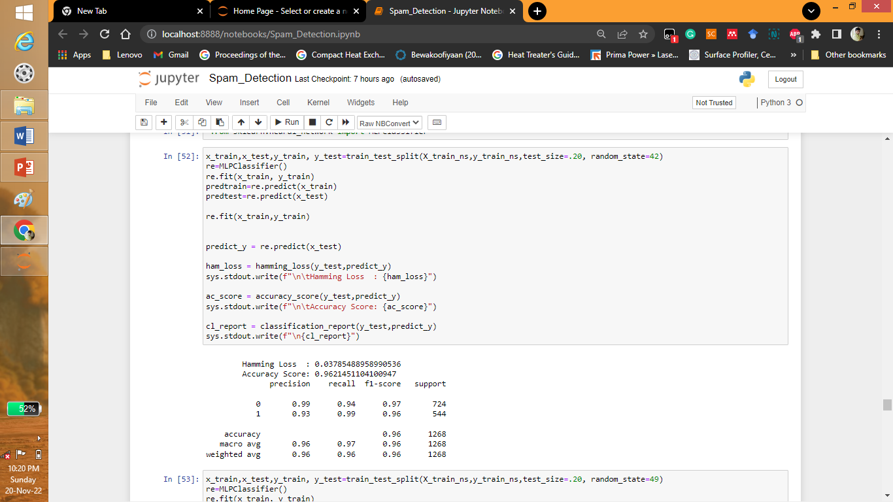
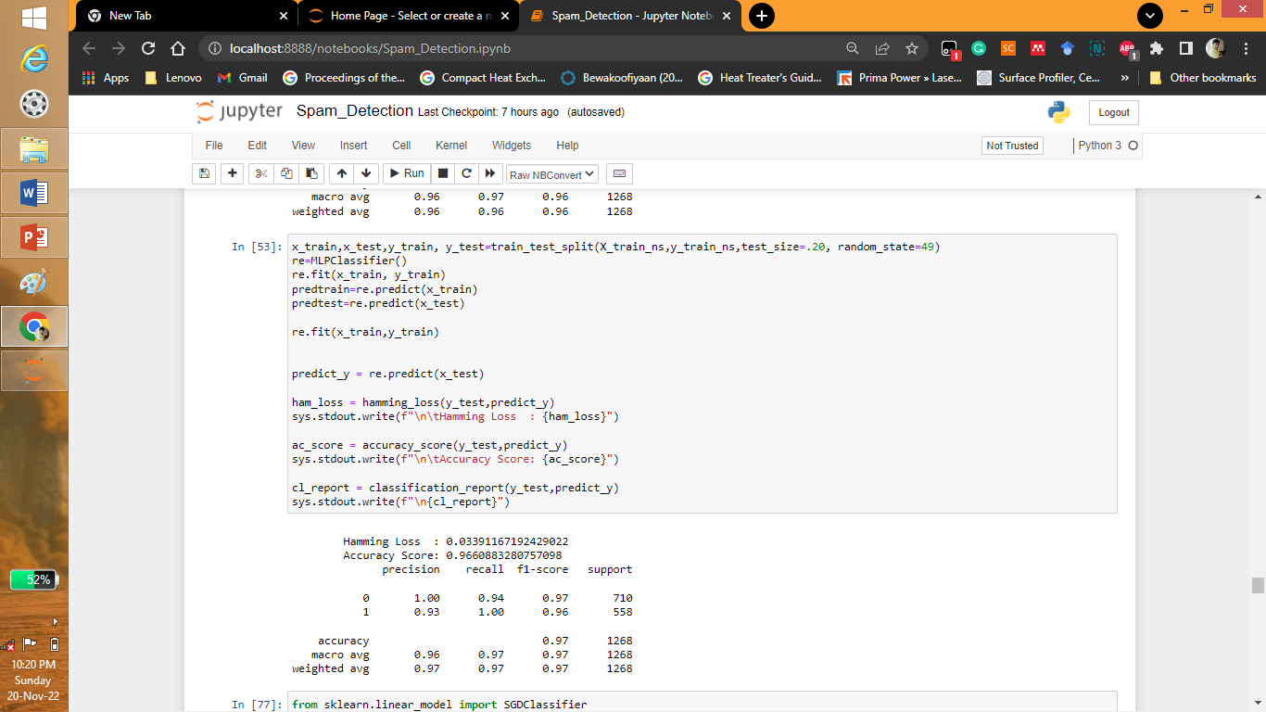
Model Building

Slide 13


Model Building

Slide 14
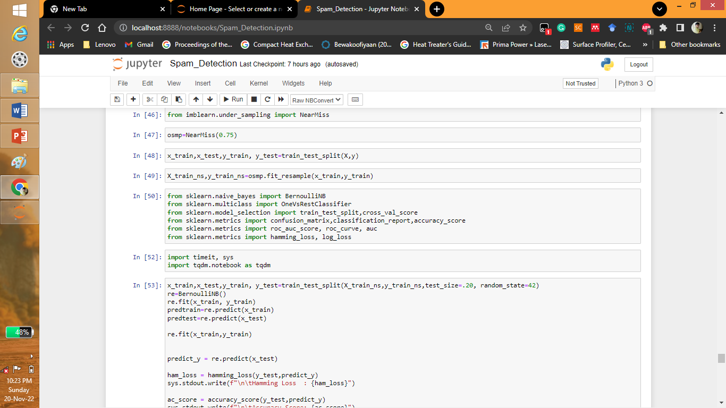
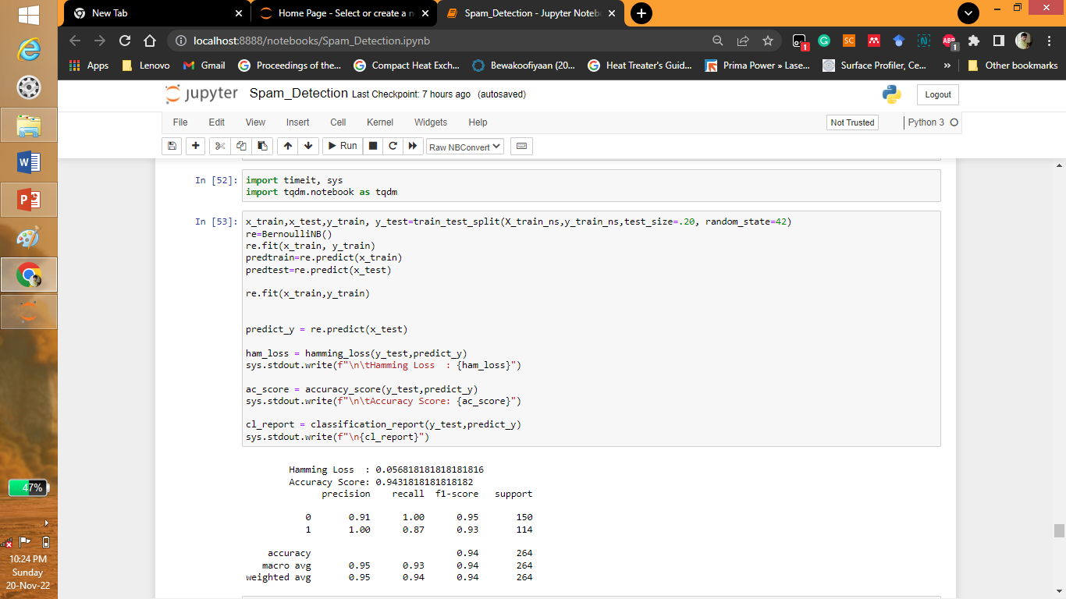
Under sampling and Model Building

Slide 15
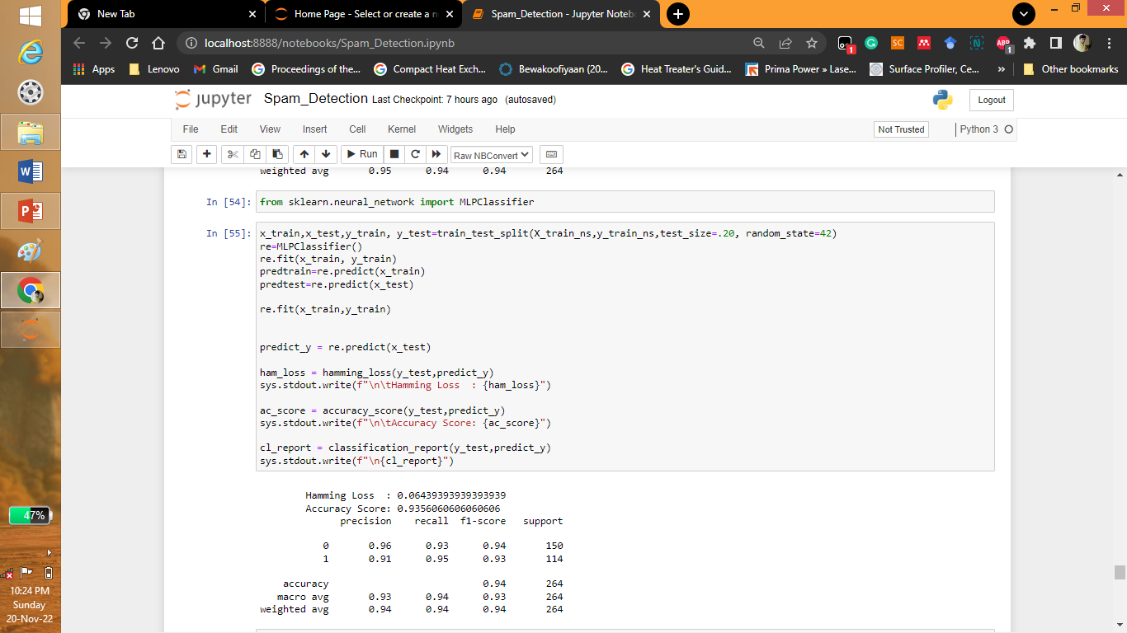

Model Building

Slide 16
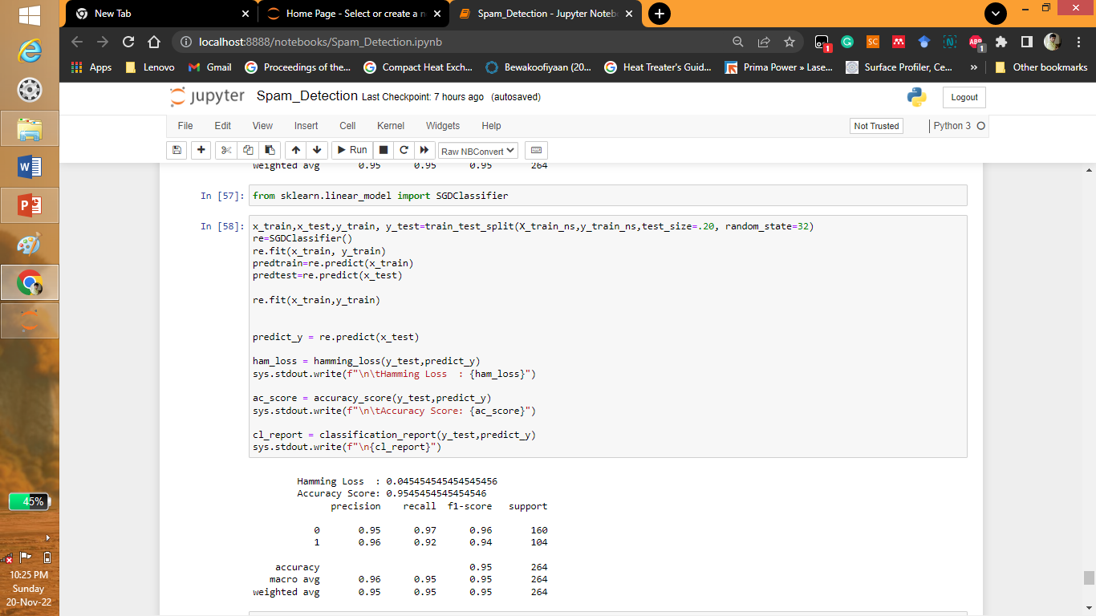

Model Building

Slide 17
Conclusion
The data was taken and cleaned. The visualization was performed and tokenized for the model.
During oversampling the model best model evalution done as Hamming Loss: 0.01971608832807571 and Accuracy Score:0.9802839116719243 from sklearn.naive_bayes of BernoulliNB.
During undersampling the model evalution done as Hamming Loss:0.045454545454545456 and Accuracy Score: 0.9545454545454546 of from sklearn.neural_network import SGDClassifier.

